Slide 1
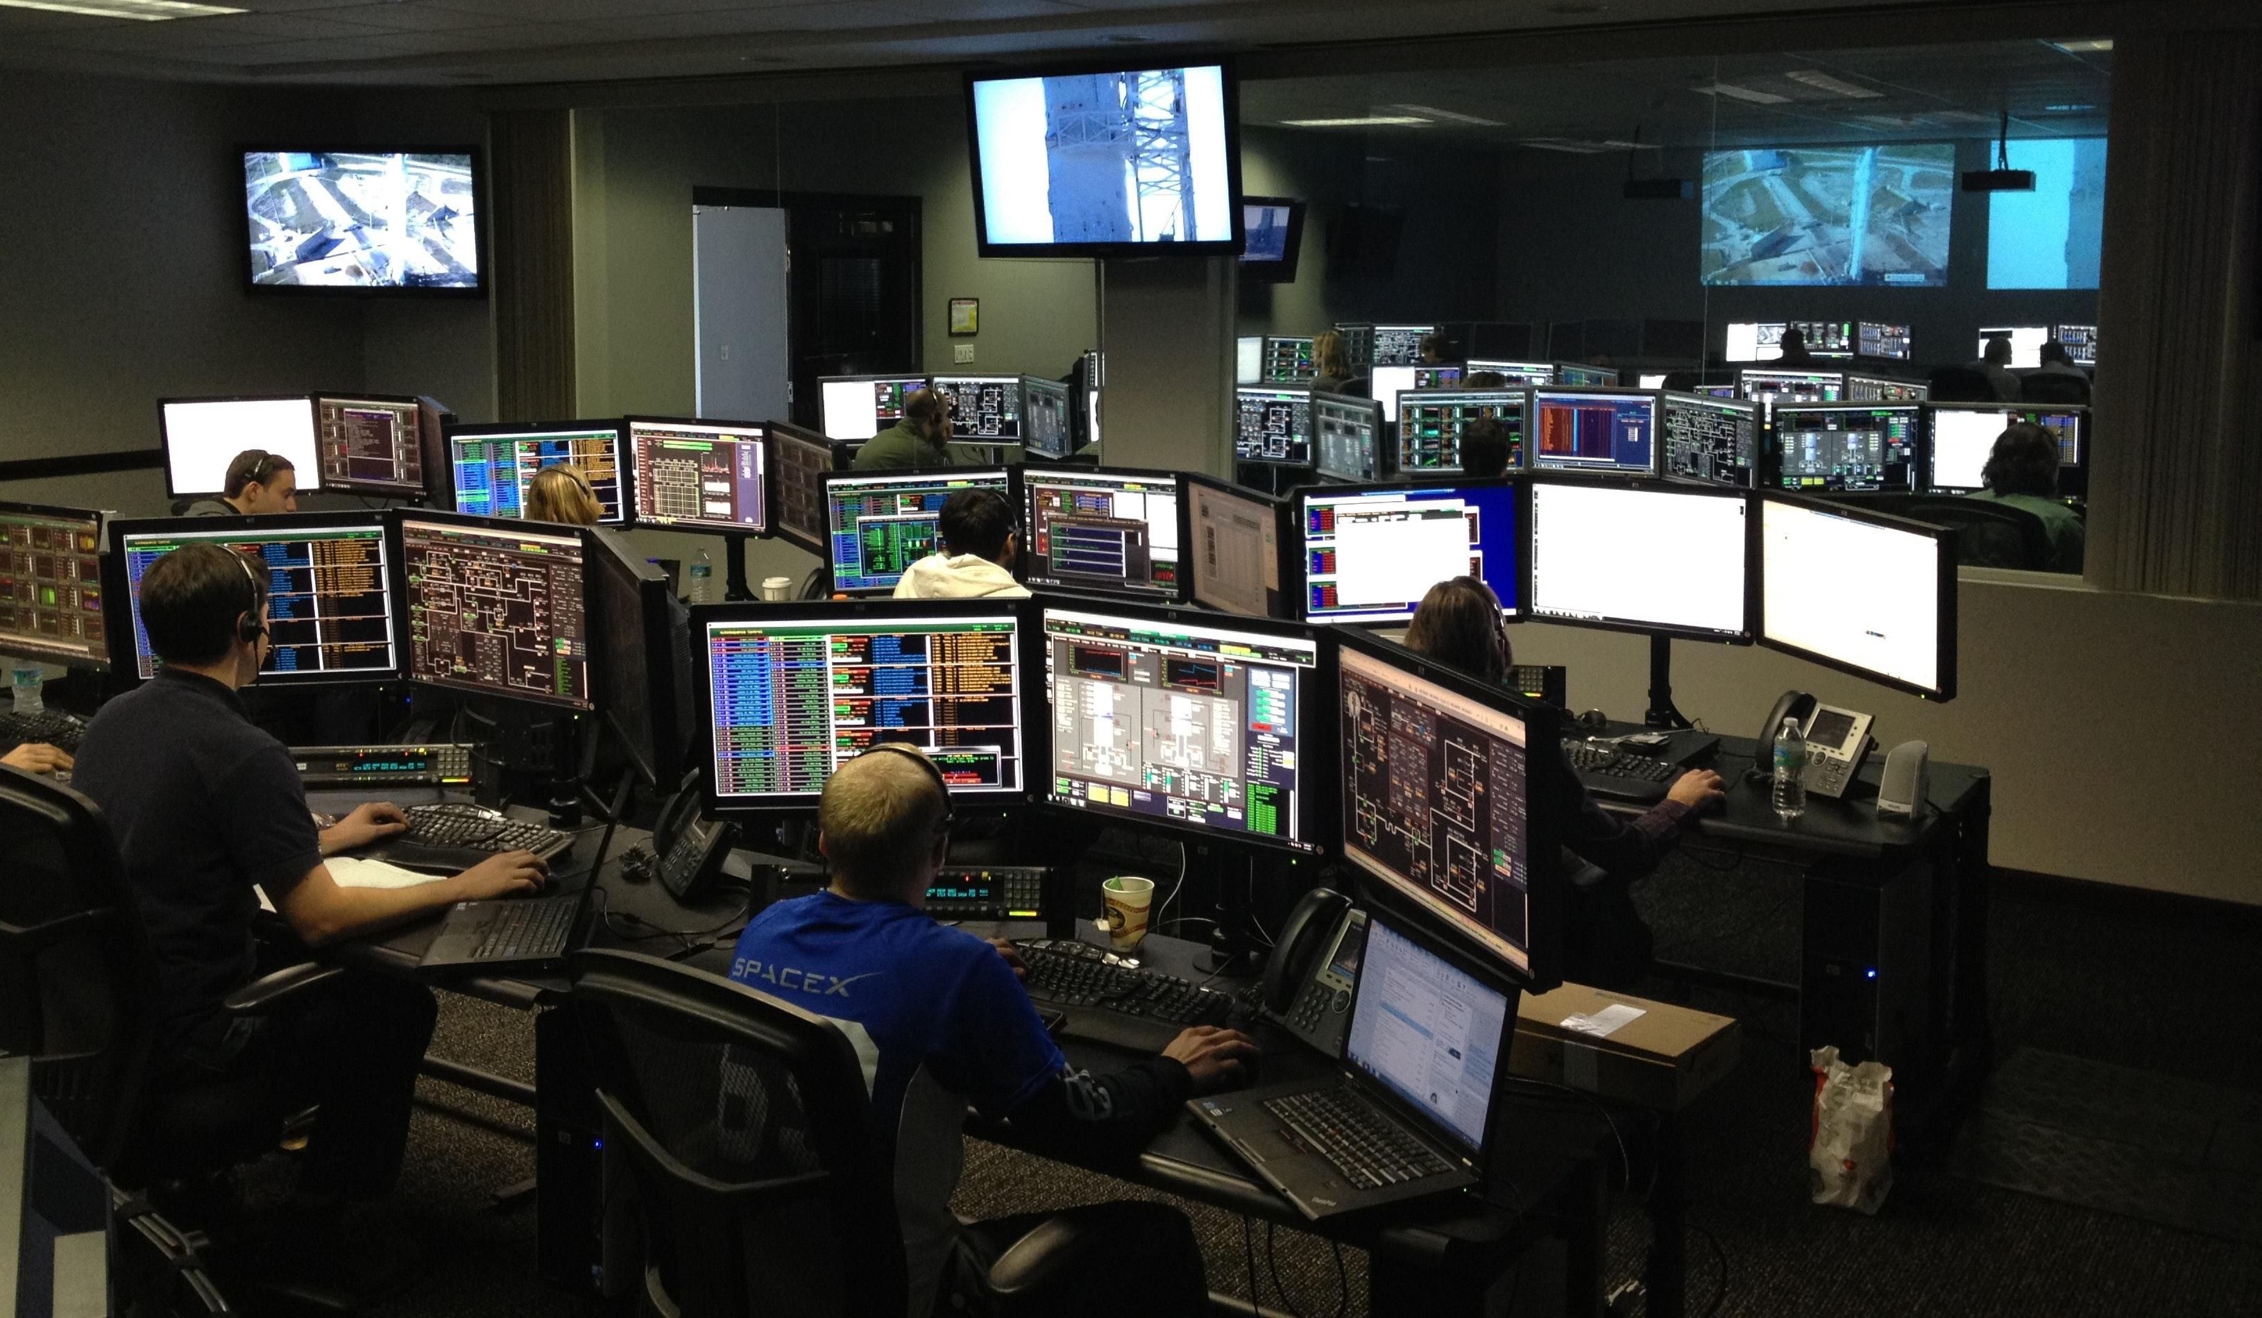
ISO/IEC 27001 Auditor
Based on ISO27001:2022
TRAINING DATASHEET
An instructor-led classroom training providing a foundational understanding of the compliance requirements of the Information Security Management System (ISMS) and what is needed for audit a ISMS against the requirements of the ISO27001:2022 standard
COURSE SYPNOSIS
ISO/IEC 27001 (ISO 27001) is an international standard for Information Security management. It provides a model to establish, implement, maintain and continually improve a risk-managed Information Security Management System (ISMS).
The standard forms the basis for effective management of sensitive, confidential information and for the application of information security controls. Demonstrating conformance to the ISO/IEC 27001 standard provides reassurance to sponsors, shareholders and customers that the organization has expert control over its risk management and data security
This course will provide participants a foundation level knowledge of how the standard operates in a typical organization and will also cover areas like Risk Management, Compliance, Cyber Security, Information Management & Analysis
This course also focus on understanding the compliance requirements of a ISMS and how to conduct an audit of the ISMS against the requirements of the ISO27001 standard

Slide 2
COURSE DURATION
2 Days Instructor Led Classroom Training
OUTLINE
The scope and purpose of ISO/IEC 27001 and how it can be used.
The key terms and definitions used in the ISO/IEC 27000 series.
How to audit organizations to identify conformity with ISO 27001.
How to evaluate the principles of risk management - including risk identification, analysis and evaluation.
How to propose appropriate treatments and controls to reduce information security risk, support business objectives and improve information security.
Leading organizations through an audit program.
Directing audit teams.
Evaluating the effectiveness of applied corrective actions to maintain ISMS conformity with ISO 27001.
WHO SHOULD ATTEND
This certification is aimed at those who are:
Third-party auditors working for Certification Bodies, responsible for conducting audits which certify organizations against ISO 27001 and ISO 19011.
Internal auditors seeking to understand the specific requirements of auditing Information Security Management Systems needed to confirm that an organization conforms to the ISO 27001 or ISO 19011 standard.
CERTIFICATION
Delegates who successfully completed the course and pass the exam will be recognized as ISO27001 Auditor certified under the APMG certification scheme.
For those delegates who do not meet the requirements stipulated in pre-requisites stated above or fail the exam would be awarded a course attendance certificate only.
PRE-REQUISITES
It is recommended (not mandated) that candidates hold the APMG ISO/IEC 27001 Foundation level (or equivalent qualification) before attending this course. The Auditor level assumes candidates have knowledge of the ISO/IEC 27001 and ISO 19011 standards, and their application in a given situation
PRE-COURSE READING
There are no pre-course reading materials needed for this course although candidates are encouraged to have the ISO/IEC27000 standards available and also be familiar with the standards
EXAMINATION FORMAT
Multiple choice format
40 questions per paper
20 marks or more required to pass (out of 40 available) – 50%
120 minute duration
Open book: ISO/IEC 27001:2022, ISO/IEC 27002:2022, ISO 19011:2018, APMG ISO/IEC 27001 Supplementary Paper
CONTACT US
#02-01 243 Beach Road Singapore 189754 +65 6729 2976
enquiries@sapience-consulting.com
www.sapience-consulting.com

